Slide 1
The shape, health and future of the church in Africa
Johannes Malherbe
SATS (South African Theological Seminary)
Johannesburg, South Africa

Slide 2
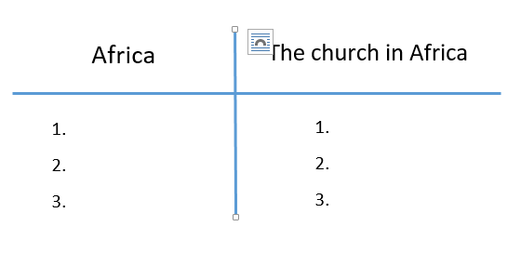

Slide 3
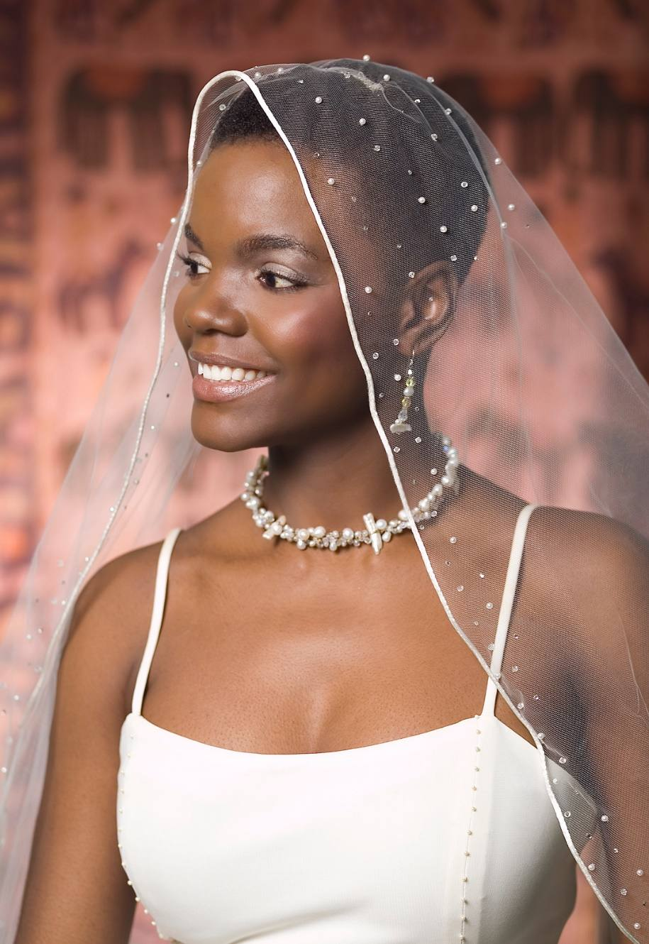
Notes:
http://www.afrobella.com/wp-content/uploads/2011/07/Khamit_Kinks_-bridal-1.jpg

Slide 4
Revelation 21
Then I saw a new heaven and a new earth, for the first heaven and the first earth had passed away, and the sea was no more. ² And I saw the holy city, new Jerusalem, coming down out of heaven from God, prepared as a bride adorned for her husband. ³ And I heard a loud voice from the throne saying, “Behold, the dwelling place of God is with man. He will dwell with them, and they will be his people, and God himself will be with them as their God. ⁴ He will wipe away every tear from their eyes, and death shall be no more, neither shall there be mourning, nor crying, nor pain anymore, for the former things have passed away.”

Slide 5
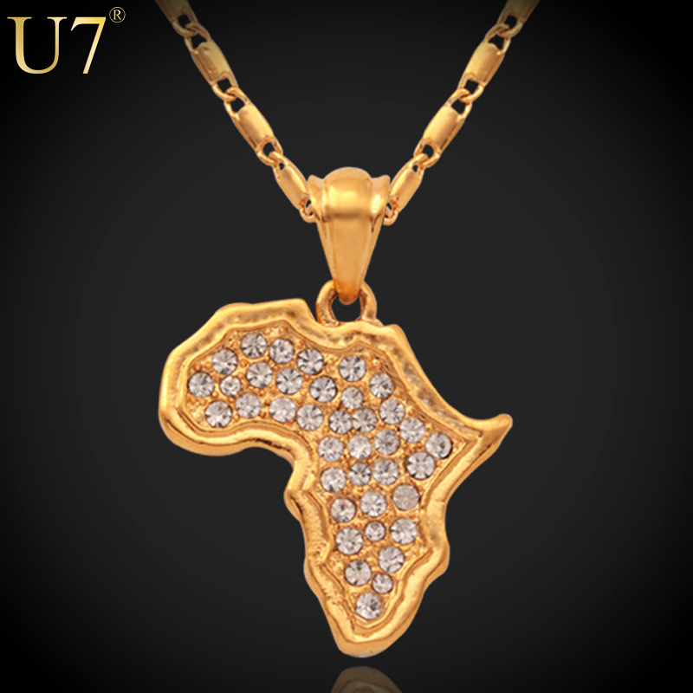
Notes:
http://g02.a.alicdn.com/kf/HTB1hc2wJVXXXXcPXpXXq6xXFXXX1/U7-18K-Stamp-18K-Real-Gold-Plated-African-Fashion-Jewelry-font-b-Women-b-font-font.jpg

Slide 6
Early church established in Africa
Unbroken presence in Egypt & Ethiopia
Evangelical growth since 19th century
Persecution & Revival
Prayer
The Holy Spirit
Biblical truth
Care & compassion
Mission
Diaspora

Slide 7
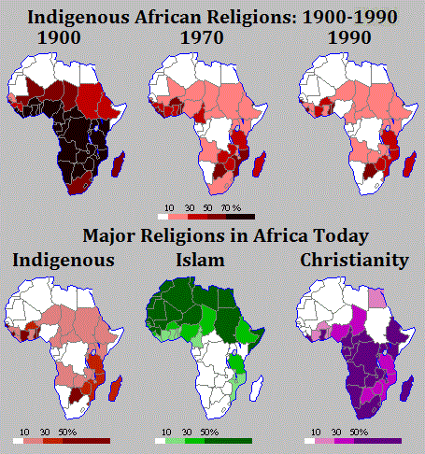
Notes:
https://decolonialatlas.files.wordpress.com/2015/03/indigenousafricanreligions1.gif

Slide 8
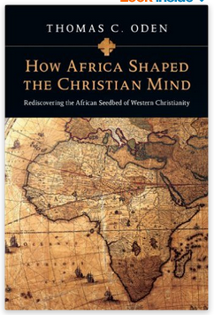
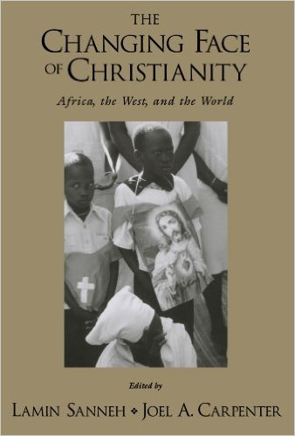


Slide 9
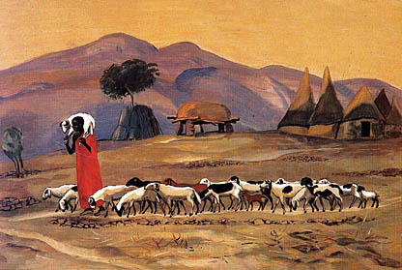
Notes:
http://www.socialtheology.com/images/shepherd.jpg

Slide 10
Ezekiel 34
The word of the Lord came to me: ² “Son of man, prophesy against the shepherds of Israel; prophesy, and say to them, even to the shepherds, Thus says the Lord God: Ah, shepherds of Israel who have been feeding yourselves! Should not shepherds feed the sheep? ³ You eat the fat, you clothe yourselves with the wool, you slaughter the fat ones, but you do not feed the sheep. ⁴ The weak you have not strengthened, the sick you have not healed, the injured you have not bound up, the strayed you have not brought back, the lost you have not sought, and with force and harshness you have ruled them. ⁵ So they were scattered, because there was no shepherd, and they became food for all the wild beasts. ⁶ My sheep were scattered; they wandered over all the mountains and on every high hill. My sheep were scattered over all the face of the earth, with none to search or seek for them.

Slide 11

Notes:
http://www.thisissierraleone.com/wp-content/uploads/2012/05/State-of-the-African-Youth.jpg

