Slide 1
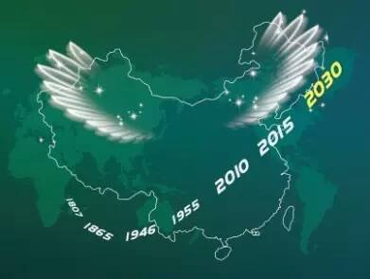
Mission China 2030
Notes:
（白话：主啊，我到你面前，献上我的敬拜）

Slide 2
Vision：
MISSION CHINA 2030
(MC2030)
Join the Nations in taking the Gospel Back to Jerusalem

Slide 3
MC0 Missiology
MC1 In-China
  Church Planting
MC2 Minority Peoples
MC3 Chinese Diaspora
MC4 Sending M’s Abroad to non-Chinese

Slide 4
2016 - 2020 Discover short mission trip opportunities
Mobilize Churches to train and send 1000 missionaries overseas
(short and long-term)

Slide 5
2021-2025
Train and send 5000 missionaries overseas
(strong member care emphasis)

Slide 6
2026-2030
Mobilize local churches to send 14,000 missionaries overseas
Send 20,000 missionaries by 2030

Slide 7


Slide 8
Please Pray for
Mission China 2030

