Slide 1
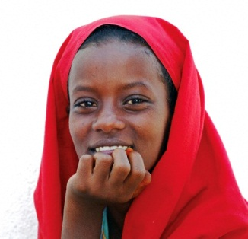
Employment in Sub-Sahara Africa -
A Concern for the Church
adapted from presentation by Louise Fox
www.worldbank.org/africa/youthemploymentreport
http://bit.ly/1aXTUXs
Notes:
Co-authors: Deon Filmer and Louise Fox, with a team consisting of Karen Brooks, Aparajita Goyal, Taye Mengistae, Patrick Premand, Dena Ringold, Siddharth Sharma, and Sergiy Zorya.
Recognize the leadership and guidance of: Shanta Devarajan and Ritva Reinikka.
And thanks to Makhtar Diop for encouragement and support through the process of producing this report.
1

Slide 2
Fact: Africa in a Young Continent … and will remain so
Sub-Saharan Africa
South Asia
East Asia and Pacific
2
Notes:
Lets start at the beginning: Africa is a young continent and will remain so for many years to come.
More than half the population in Sub-Saharan Africa is under 25 years old. Each year between now and 2035, there will be half a million more 15 year olds than the year before.
Population pyramids, illustrated here, show how the structure of SSA’s population differs from that in other regions. The wide base shows just how many more young people there are compared to older people. And this structure is not projected to change rapidly.
Indeed, the fertility transition whereby family sizes fall rapidly has not happened at the regional level—unlike other regions. Of some concern is that the fertility transition started in some countries but has since stalled.
If Africa is to reap a so-called demographic dividend, then fertility rates must fall rapidly.
While the large youth population is a challenge it also presents opportunities—African countries should take the actions to harness those opportunities.
2

Slide 3
Story Highlights
1. Eleven million youth are expected to enter Africa’s labor market every year for the next decade.
2. Despite rapid growth in formal wage sector jobs, the majority of these youth are likely to work on family farms and in household enterprises, often with very low incomes.
3. To boost young people’s earnings, governments need to hasten overall business climate reforms, strengthen basic education, and make land, infrastructure, training and financing more accessible.

Slide 4
Churches need to be aware and interact with government, NGOs and aid agencies
about the issue
YE is about building skills through improving the quality of education, as well as behavioral and business skills
A wide ranging
agenda …
with no simple answers
YE is about agriculture – where strategies exist but have not been implemented, and could benefit from a youth lens
YE is about household non-farm enterprises – where few strategies exist - 50 million households
YE is about helping youth overcome multiple constraints, including those that especially hold back particular groups such as young women
Notes:
Before moving to some of our more specific recommendations, we want to emphasize that there are no “silver bullets” to addressing this challenge.
Governments need to own the whole problem.
YE is about building skills through improving the quality of education, as well as behavioral and business skills
YE is about agriculture – where strategies exist but have not been implemented, and could benefit from a youth lens
YE is about household non-farm enterprises – where few strategies exist
YE is about creating more labor intensive enterprises as fast as possible to absorb the supply of new entrants with education who want wage jobs
YE is about helping youth overcome multiple constraints, including those that especially hold back particular groups such as young women
4

Slide 5
Two types
2 types of entrepreneurs: well / less educated professional / less skilled
2 focus areas : Christian missionary business / family business
2 areas of business : regular / ICT4D
2 area of focus: same culture / cross-cultural
2 exposures to work: more experience / less experience
1. Build the entrepreneurial capacity of your unit
Start by gathering information from
Spirit-filled Christian business persons
NGOs, Aid agencies – Christian and non-Christian
Learn the “entrepreneur space” or “Ecosystem” - Map it out of your
country, region, or city.
Be organized; act in unity? Why?
2. Two pronged training: Foundation for Christian business
Christian business for church members
Christian business as mission / Kingdom building

Slide 6
Caveats
Entrepreneurship can be hard, only 1 or 2 out of 20 persons succeed.
It helps to have work experience (but not totally necessary).
It is NOT the ONLY solution to building support
For mission work, one of the best uses is in areas that require Creative Access and where building relationships is necessary
Do NOT think of business believers only as a source of money. They can be meaningfully engaged in ministry of evangelism, church planting, and discipleship
Do not give in to the temptation of a pretend business

Slide 7
Worldly Entrepreneurship: A process by which self-driven individuals participate in a free market economy for the purpose of creating wealth for themselves and controlling resources
Biblical Entrepreneurship (BE): A biblically-based process of identifying opportunities, taking calculated risks, solving problems and exercising business stewardship for biblical profit.
Kingdom Business: God’s business, managed God’s way, by God’s steward, for God’s purposes in the world.

Slide 8
Biblical Profit: The spiritual and natural gain remaining after all costs are deducted from a business transaction or the total income of the business.
Kingdom Business: God’s business, managed God’s way, by God’s steward, for God’s pur poses in the world.

Slide 9
Kingdom Business:
Search for:
Nehemiah Project international
Patrice Tsegue
Regent Center for Entrepreneurship
Kenya, Uganda, other countries

Slide 10
Three modules
Part I: Introducing Biblical Entrepreneurship
BE Entrepreneurship Attitude
BE Character
How to identify opportunities
How to take calculated risks
How to Solve Problems
Understanding Stewardship
Understanding Biblical Profit
Goals and Responsibilities
Part II: Tools of Business
Part III: Developing your Business Plan

Slide 11
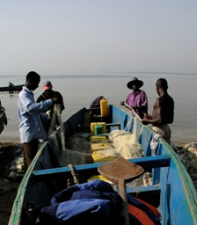
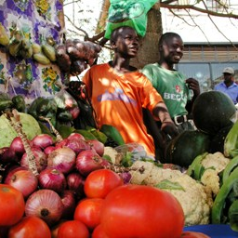
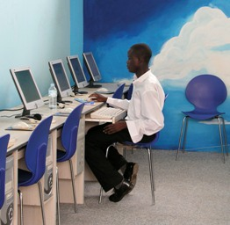
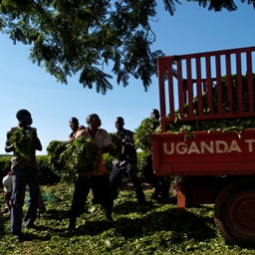
Thank you
Notes:
11

