Slide 1
AFRICAN WOMEN IN MISSIONS NETWORK (AWIMN)
The African Women in Missions Network (AWIMN) is a strategic network of the Movement for African National Initiatives (MANI)
Vision and General Objectives of MANI
The Movement for African National Initiatives (MANI) is a network of networks focused on catalyzing African National Initiatives and mobilizing the resources of the Body of Christ in Africa for the fulfillment of the Great Commission.

Slide 2
MANI's purpose is to affirm, motivate, mobilize and network Christian leaders by inspiring them with the vision of reaching the unreached and least evangelized in Africa, and the wider world
The MANI Vision is that: "Africa be filled with the knowledge of the glory of the LORD, as the waters cover the sea" (Habakkuk 2:14)

Slide 3
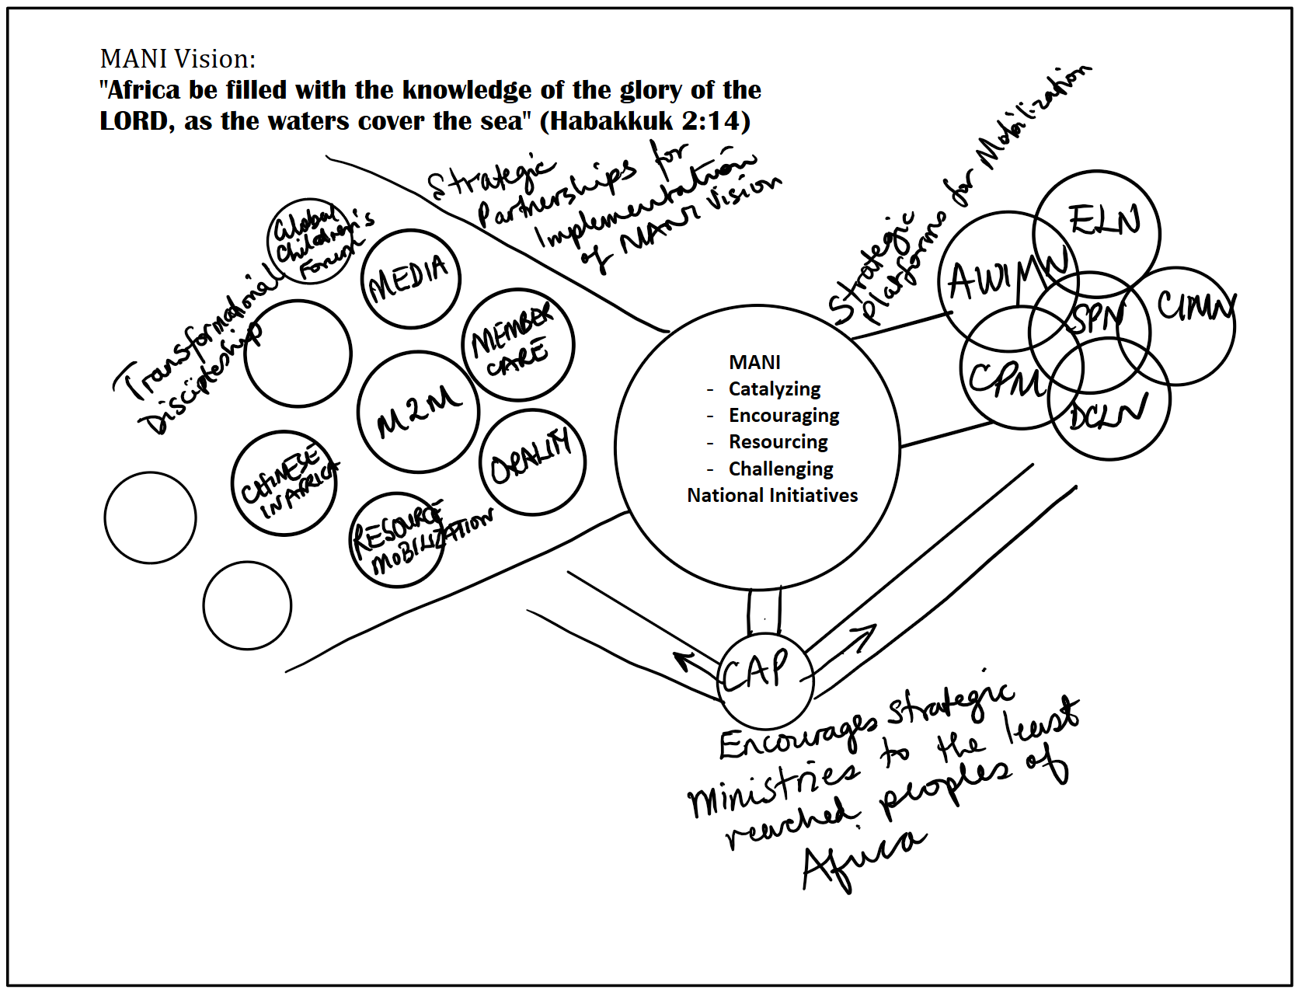

Slide 4
Vision and General Objectives of AWIMN
The Great Commission is a command given to women and men. The African Women in Missions Network is focused on the mobilization of women in realization of the strategic role they play in the fulfillment of the Great Commission and in finishing the task of reaching the remaining least reached peoples of the world.
AWIMN seeks to encourage and empower women in missions by mobilizing them to:
Play a significant role in reaching the least evangelized peoples and nations worldwide (world mission)
Participate actively in the development of a cooperative national strategy designed to saturate their countries with accessible groups of believers (saturation church planting) and facilitate a process of transformation (radical transformation).

Slide 5
These will be carried out by:
Developing partnerships and relationships with existing women’s networks in Africa and seeking to mobilize and empower them to discover their role in God’s missional purpose.
Mobilizing women to participate in the other MANI Strategic and Functional Networks including the Country Assessment Process (CAP), and national initiatives because women are critical to the realization of their objectives

